Slide 1

Instructor Notes
Ensure you update your contact information on the Title slide
This class is a combination of Lecture, Demo and Lab
Class duration is expected to be approximately 4 hours
All Demos and Labs are described in the slide Notes
File Student Modeling_PreClass.pbix does not have all DAX applied, and will be used by the students in Labs.
Save a copy of this file to add DAX and perform demos during class. It is easier to save a copy as in one demo, you will need to show “before and after” file sizes
File Instructor Complete Modeling.PBIX has all complete DAX and relationships applied. Use this file for Demos.
Answers to the Knowledge Checks can be found in the Appendix
Both PBIX files have a FullPath parameter which can be adjusted to the location of the source data file VanArsdel_Actuals.xlsx
Download and install Power BI Desktop:
Download and install Microsoft Power BI Desktop from: http://www.microsoft.com/en-us/download/details.aspx?id=45331
Version: 20170428
Notes:
Changes:
Removed all M and C notations for measures and calculated columns in the formulas and notes
Replaced “Advanced DAX” with “data modeling”

Slide 2

Instructor name
Title
Email
Version: March_2017
Notes:
Purpose of this presentation: Power BI Modelling
Target audience: Analysts, Report Builders

Slide 3
Prerequisites and Setup Steps
Internet connectivity: You must be connected to the internet
At minimum, a computer with 2-cores and 4GB RAM running one of the following version of Windows: Windows 7,
Windows 8, (64-bit preferred), Windows 8.1 or Windows 10 or Windows Server 2008 R2 or Windows Server 2012/R2
Microsoft Power BI Desktop requires Internet Explorer 9 or greater
Verify if you have 32bit or 64bit operating system to decide if you need to install the 32bit or 64bit applications.
Search for computer on your PC, right click properties for your computer
You will be able to identify if your operating system is 64 or 32 bit based on “system type” as shown below
Download and install Power BI Desktop: Download and install Microsoft Power BI Desktop from http://www.microsoft.com/en-us/download/details.aspx?id=45331. Optionally, you can also install the Power BI Desktop tool from the Power BI Desktop Install folder on the flash drive that will be provided on the day of the session. Please choose appropriate 64-bit or 32-bit version depending on your platform. Microsoft Power BI Desktop is available for 32-bit (x86) and 64-bit (x64) platforms
Download Class Files:
Copy Files from your USB to C:\Power BI_Adv_Model\ (Please return the USBs)
NOTE: This lab is using real anonymized data and is provided by ObviEnce LLC. Visit their site to learn about their services: www.obvience.com .
This data is property of ObviEnce LLC and has been shared for the purpose of demonstrating PowerBI functionality with industry sample data. Any uses of this data must include this attribution to ObviEnce LLC.
Notes:
If you choose to put your class files in a different folder than noted on the slide, update the path in the FullPath parameter.

Slide 4



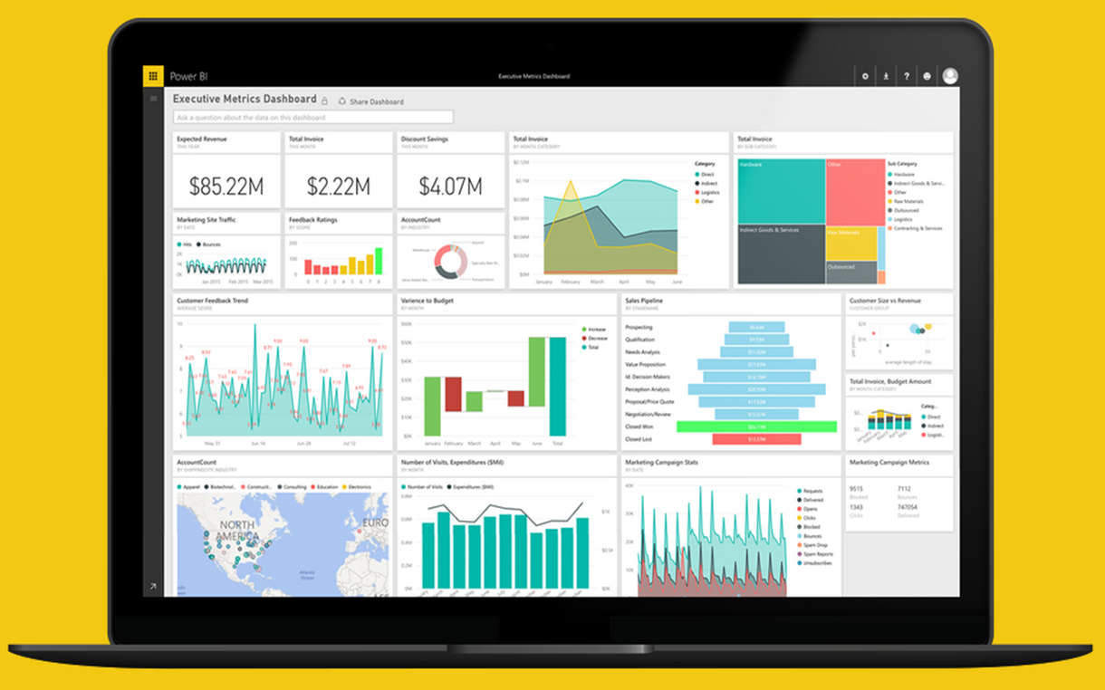
Project Professional Workshop Program
Module 4 – DAX Deep Dive

Slide 5
COURSE OBJECTIVES
By the end of this course, you will be able to use DAX to create calculations in a Power BI Desktop data model. Specifically you will be able to:
Understand basic concepts of Data Modeling
Understand the consequences of data model design decisions
Understand concepts of calculated columns and measures
Gain familiarity with standard DAX patterns & CALCULATE
Understand evaluation contexts and their impact on calculations
Gain ability to parse data modeling formulas

Slide 6
Recap & DAX Concepts Module 4a

Slide 7
Module 4a - DAX Evaluation Contexts
Any DAX expression is evaluated inside a certain context
The context is the environment under which the formula is evaluated
“The surrounding area of the cell where DAX evaluated the formula”
2 Kinds
Row Context – the context that always contain a single row and DAX defines during the creation of the formula
Filter Context – based on the context defined by it’s current filters & environment
Notes:
Context
Oh boy…. This is the tough one
This does take some time to understand, but basically every DAX expression is evaluated inside a certain “environment”
This depends if it is a column or a measure, in a table or on it’s own
Row Context
More for Calculated Columns – iterates on every row of a table/column
Cannot look at other rows! Just the one it is on
Filter Context
Based on the current area or situation a expression is in
Can ignore row context, especially aggregations.
Not based on every row
For example, a measure of total sales when adding different columns and rows

Slide 8
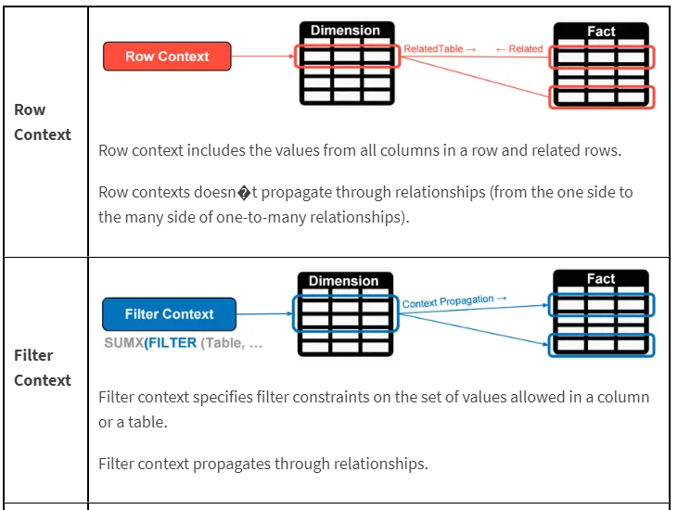
Module 4a – DAX Evaluation Contexts
Filter Context
Comes initially from the visual coordinates.
Can be modified by the functions like CALCULATE().
Follows the one to many relationships automatically.
Bidirectional filtering can be forced.
Row Context
Exists in calculated columns.
Exists in special DAX functions like SUMX and FILTER.
Does not follow relationship.
A row Context does not create a filter context.

Slide 9
Module 4a – DAX Evaluation Contexts
Operator Type | Symbol and Use
Parenthesis operator | () precedence order and grouping of arguments
Arithmetic operators | + (addition) - (subtraction/ sign) * (multiplication) / (division) ^ (exponentiation)
Comparison operators | = (equal to) > (greater than) < (less than) >= (greater than or equal to) <= (less than or equal to) <> (not equal to)
Text concatenation operator | & (concatenation)
Logic operators | && (and) || (or)

Slide 10
Filter Context in a Measure
Module 4a – DAX Evaluation Contexts
[Total Sales] = SUM(Sales[Sales Amount])
Better definition of above measure:
“Total Sales” – SUM of Sales[Sales Amount] column under a filter context
Notes:
A measure is not evaluated until it is in a Visual – and will be under a filter context

Slide 11
DAX Function Types
Module 4a – DAX Evaluation Contexts
Scalar Functions
Table Functions
Scalar functions return a Single value as an output
Ex. SUM(Sale[Sales Amount])
Table functions return a Table as an output
Ex. ALL(GeographyDim)
There are other ways to classify functions – By kind of operation they perform etc.
Notes:
Scalar is a fancy word for using a single coordinate in the evaluation
What if you want bring in a Table or List of values and apply your calculation to them?

Slide 12
Applications of Table functions
Module 4a – DAX Evaluation Contexts
Table functions can be used 2 ways in Power BI Desktop
As an input to another DAX function
CALCULATE
Iterator functions
Calculated Tables
Notes:
Demo CALCULATED Table example in Power BI Desktop model
Call out the fact that CALCULATED Tables are just like a calculated column – Calculated during processing time or refresh time
You can use this table just like any other DAX in the model – You can create relationships etc.
Go to the Desktop and create a new Demo Table = ALL(GeographyDim) – duplicate with a separate memory footprint.

Slide 13
Basic TABLE functions
Module 4a – DAX Evaluation Contexts
Return All Rows
Return Distinct Rows
Return Filtered Rows
ALL & variants
ALL, DISTINCT, VALUES
FILTER
There are more advanced Table functions, which we will not cover
Notes:
We will discuss three classes of Table function
No demo yet.

Slide 14
Basic Table functions – Return All Rows
Module 4a – DAX Evaluation Contexts
The ALL function - Can take either Table or Columns in a Table as input
ALL with Entire Table
ALL with One Column
ALL with Multiple Columns
ALL(GeographyDim)
ALL(GeographyDim[Region]))
ALL(GeographyDim[Region],
GeographyDim[State])
Returns all rows all columns in Table
Returns all unique values of Column
Returns all unique combinations of Column values
Notes:
Demo:
Create a Demo Calculated Table. Discuss Calculated Tables and how are they created.
DemoTable = All(GeographyDim).
Calculated Tables can be used like any other table
You can Build relationships
You can use this to test other complex Table functions
These are like Calculated Columns – Computed during process time
Show ALL and its variants – Start with ALL and work your way through (use slide as a guide)

Slide 15
Basic Table functions – ALL versions
Module 4a – DAX Evaluation Contexts
There are several forms of the ALL function
ALL
ALLEXCEPT - Return all columns in a Table except 1 or more columns
ALLSELECTED – Return all values in a column selected by users in Slicers
ALLNONBLANKROW – Return all non-Blank rows
Notes:
We demonstrated these functions in the CALCULATE section
Table1 – has a duplicate row
When I write ALL on the whole table, I get the whole table
When I write ALL on the two columns of the table, it removes duplicates
Blank vs a mismatch
ALLEXCEPT - Overrides all context filters in the table except over the specified columns; useful when you want only one column on a table to be sliceable
ALLSELECTED – just like ALL, but if the column is specifically selected, then it respects the slicer
ALLNONBLANKROW – Just like ALL, but does not return any blank rows

Slide 16
Basic Table Functions – Return Distinct Rows
Module 4a – DAX Evaluation Contexts
VALUES – Return all distinct values in a column or Table
(including blank rows)
DISTINCT - Return all distinct values in a column or Table
(not including blank rows)
Notes:
If when you write VALUES and get a blank you may have Blank or MisMatch
If you change a VALUES to DISTINCT and you still have blank – then it is a real blank – NOT A MISMATCH
Blank vs a mismatch – If your model has Fact rows which do not match with dimensions, this is a mismatch – not a true blank.

Slide 17
Module 4a – DAX Evaluation Contexts
FILTER in DAX – Powerful feature of our Tables
FILTER ( <table>, <filter expression to be evaluated for each row>)
Creating Filters inside of filter context
Like creating a new scope for your DAX expression
Notes:
Remember – every DAX expression that requires a table is creating a virtual table to apply your logic. When you use a filter or a calculate in a function, it is actually virtually storing a model / table based on that context.
This is also true of any measure in a visual. Based on the fields you have in a visual, the DAX expression is still storing a virtual table.

Slide 18
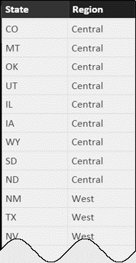
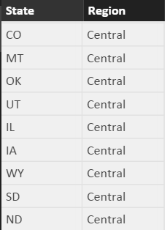
Basic Table Functions – Return Filtered Set of Rows
Module 4a – DAX Evaluation Contexts
FILTER(ALL(GeographyDim[Region], GeographyDim[State]), GeographyDim[Region] = “Central”)
Take all unique combinations of GeographyDim[Region], GeographyDim[State]
Filter down to the rows where GeographyDim[Region] = “Central”
Notes:
The Region = “Central” is in a ROW Context as it is not surrounded by aggregate function

Slide 19
Module 4a DEMO

Slide 20
Module 4a DEMO – Returning Tabular Values
Lets create some Tables!
Creating a Filter Context!
Use Calculated DAX ALL to create 3 Cal. Tables.
The entire GeoDim Table
All of Region column from GeoDim
All of State & Region from GeoDim

Slide 21
Module 4a DEMO – Returning Tabular Values
Use Filter to create a new “Scope”
Create a new Table using ALL but with a Filter first and only show “East” Region

Slide 22
Module 4b
CALCULATE

Slide 23
MODULE 4b OBJECTIVE
Understand the basics of the CALCULATE formula

Slide 24
PATH to DAX Expertise
Module 4b – CALCULATE & Variables
Evaluation Contexts
CALCULATE
Calculated Columns and Measures
Notes:
Evaluation Context – Single biggest reason that people give up on DAX
Want to Simplify the Evaluation Context

Slide 25
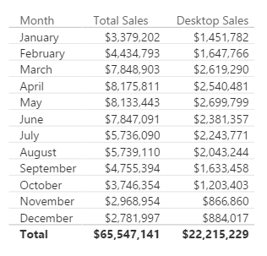
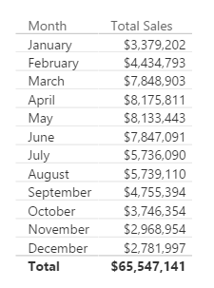
Why is CALCULATE Useful?
Module 4b – CALCULATE & Variables
Typical Business Question:
Provide a break out of this Sales from Desktop
You create a report of breakdown of Sales by Month
Notes:
In Excel, there are SUMIF and SUMIFS functions – Calculate give you that flexibility and much more as it can be used with ANY Aggregation/Calculation
MYR – Drill to one Department’s data – and change the shape and it will all still work

Slide 26
Here is how you do it with CALCULATE
Module 4b – CALCULATE & Variables
[Desktop Sales] = CALCULATE([Total Sales], CampaignDim[Device] = "Desktop")
Use CALCULATE function to create a Measure which filters down to Desktop Sales
Notes:
Note that even if you apply a “Device” Slicer to this page, the measure [Desktop Sales] will always show Desktop

Slide 27
Anatomy of CALCULATE
Module 4b – CALCULATE & Variables
CALCULATE(Expression, [Filter 1], [Filter 2]…..)
Filter Arguments
EXPRESSION used as the first parameter is essentially the same as a measure
CALCULATE works differently from other DAX functions
The second set of arguments, i.e. the “Filter arguments,” are evaluated and applied first
Then the Expression is evaluated under new “Filter Context"
Notes:
ALL Filters arguments are ANDs – FILTERS ARE CALCULATED FIRST (to filter the rows), then the math is applied

Slide 28
CALCULATE – Steps in Evaluating the CALCULATE Function
DAX Foundations
CALCULATE(Expression, [Filter1], [Filter2]…..)
Step1 : Copy the current filter context
Step 2: Add new filters if any
Step 3: Update/ignore existing filters if any
Step 4: Convert row context to filter context
Step 5: AND all filter conditions to create new filter context
Step 6: Evaluate the Expression
Step 7: Return back to original filter context
Notes:
ALL Filters arguments are ANDs – FILTERS ARE CALCULATED FIRST (to filter the rows), then the math is applied
Within one Filter argument, you can use the double pipe “||” to “or” conditions together. See the Example in YTD Revenue.

Slide 29
CALCULATE – The Most Important Function in DAX
Module 4b – CALCULATE & Variables
4 Key functions that CALCULATE can do:
Add Filter
Ignore Filter
Update Filter
Convert Row Context to Filter Context
Notes:
Transition slide

Slide 30
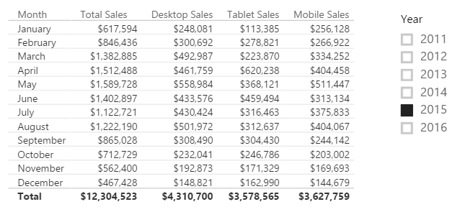
CALCULATE – Add Filter
Module 4b – CALCULATE & Variables
[Desktop Sales] = CALCULATE([Total Sales], CampaignDim[Device] = "Desktop")
[Tablet Sales] = CALCULATE([Total Sales], CampaignDim[Device] = “Tablet")
[Mobile Sales] = CALCULATE([Total Sales], CampaignDim[Device] = “Mobile")
Notes:
Demo: Table from “Calculate-Add” report
Note the effect that the Year Slicer has on the table (All items change)
When the Device Slicer is selected, only “Total Sales” changes.
Filter Context : Jan + 2015
Jan + 2015 + Desktop
Jan + 2015 + Tablet

Slide 31
CALCULATE – The Most Important Function in DAX
Module 4b – CALCULATE & Variables
4 Key functions that CALCULATE can do
Add Filter
Ignore Filter
Update Filter
Convert Row Context to Filter Context

Slide 32
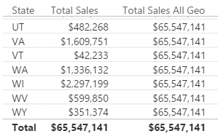
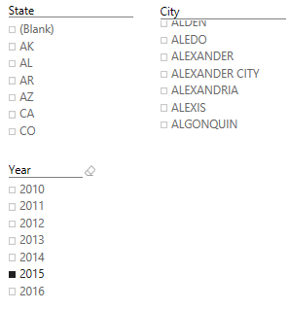
CALCULATE – Ignore an Existing Filter
Module 4b – CALCULATE & Variables
[Total Sales All Geo] = CALCULATE([Total Sales], ALL(GeographyDim))
Notes:
DEMO “Calculate- Ignore” Tab:
The table visualization, with each slide, expose the related column
Expose measure called [Total Sales All Geo] – Ignore filter on ANY column from the GeographyDim table, but allows filters from Year
Discuss that this measure can be used to calculate a % of Total measure

Slide 33
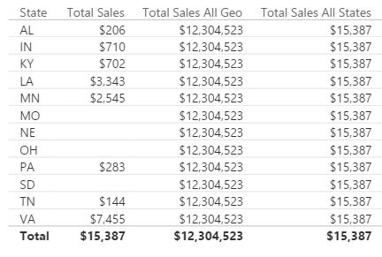
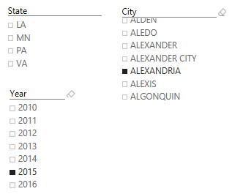
CALCULATE – Ignore an Existing Filter
Module 4b – CALCULATE & Variables
[Total Sales All States] = CALCULATE([Total Sales], ALL(GeographyDim[State]))
Notes:
DEMO “Calculate- Ignore” Tab:
The table visualization, with each slide, expose the related column
Expose measure called [Total Sales All State] – Ignore filter on the STATE column from the GeographyDim table, but allows filters from Year
Slice on City (Aberdeen is good)

Slide 34
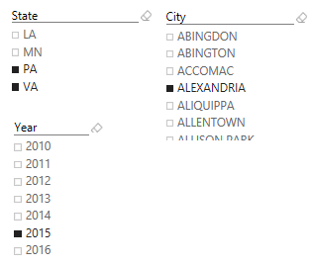
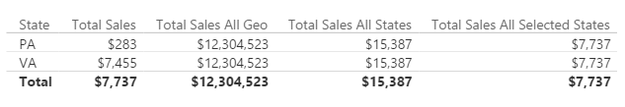
CALCULATE – Ignore Existing Filter
Module 4b – CALCULATE & Variables
[Total Sales All Selected States] = CALCULATE([Total Sales], ALLSELECTED(GeographyDim[State]))
Notes:
DEMO “Calculate- Ignore” Tab:
The table visualization, with each slide, expose the related column
Expose measure called [Total Sales All Selected State] – Ignore filter on the STATE column from the GeographyDim table, but allows filters from Year
Slice on City (Aberdeen is good), then select multiple State, see that the measure now only displays the total for selected states.

Slide 35
CALCULATE – The Most Important Function in DAX
Module 4b – CALCULATE & Variables
4 Key functions that CALCULATE can do
Add Filter
Ignore Filter
Update Filter
Convert Row Context to Filter Context

Slide 36
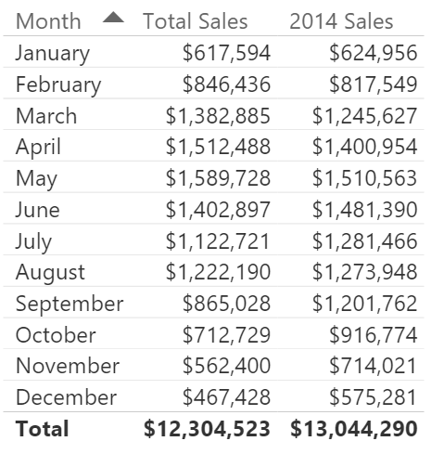
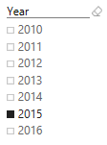
CALCULATE – Update Existing Filter
Module 4b – CALCULATE & Variables
[2014 Sales] = CALCULATE([Total Sales], DateDim[Year] = 2014)
Notes:
DEMO “Calculate- Update” Tab:
The measure called [2014 Sales] – Ignores filter on the Year Slicer.
This is different than just using FILTER because Calcuate updates the filter context, FILTER creates a filter Context

Slide 37
Module 4b – CALCULATE & Variables
Calculate & DAX Context can be nested
Use Variables!
Stores the result of an expression and it’s value to another expression
Scope of Variable stays the same
VAR <variableName> = Expression RETURN
Can apply multiple Filters inside one DAX expression

Slide 38
Module 4b DEMO

Slide 39
Module 4b – DEMO – Add Filter
Add Filter Feature of Calculate
Let’s Create some Measures of Desktop, Tablet, and Mobile Sales using Calculate
Add to a table & visual on Table to compare

Slide 40
Module 4b – DEMO – Ignore Filter
Using Ignore filter of Calculate
Create 3 measures using the same return of those Calculated Tables and ALL
Total Sales ALL of GeoDim
Total Sales of ALL of GeoDim (just States)
Total Sales of GeoDIM

Slide 41
Module 4b – DEMO – Update Filter
Updating a filter of a expression using Calculate
Add a tab with a table of Month & Total Sales
Add filter of Year
Create a 2014 & 2015 Measure
Notes:
Remember – when you create a CALCULATE it will update a filter based on its current context. But using a FILTER in a expressions CREATES the context. That is why it is different here.

Slide 42
Module 4b – DEMO – Update Filter
Updating a filter of a expression using Calculate
Go back to Desktop, Mobile, Tablet sales measures
Lets try to get the % of Sales per device.
Calculate inside a Calculate

Slide 43
Module 4b – DEMO – Variable Filter
Use a Variable for easier debugging and reference to get ALL Sales for Device Type
% Device Sales (var) =
VAR AllDevice = CALCULATE([Total Sales],ALL(CampaignDim[Device]))
Return
DIVIDE([Total Sales],AllDevice)

Slide 44
Module 4c Popular DAX

Slide 45
Module 4c – Popular DAX Expressions
Fantastic Functions and Where to Find them
Over 200+ DAX functions, with 10 Categories
New ones added monthly

Slide 46
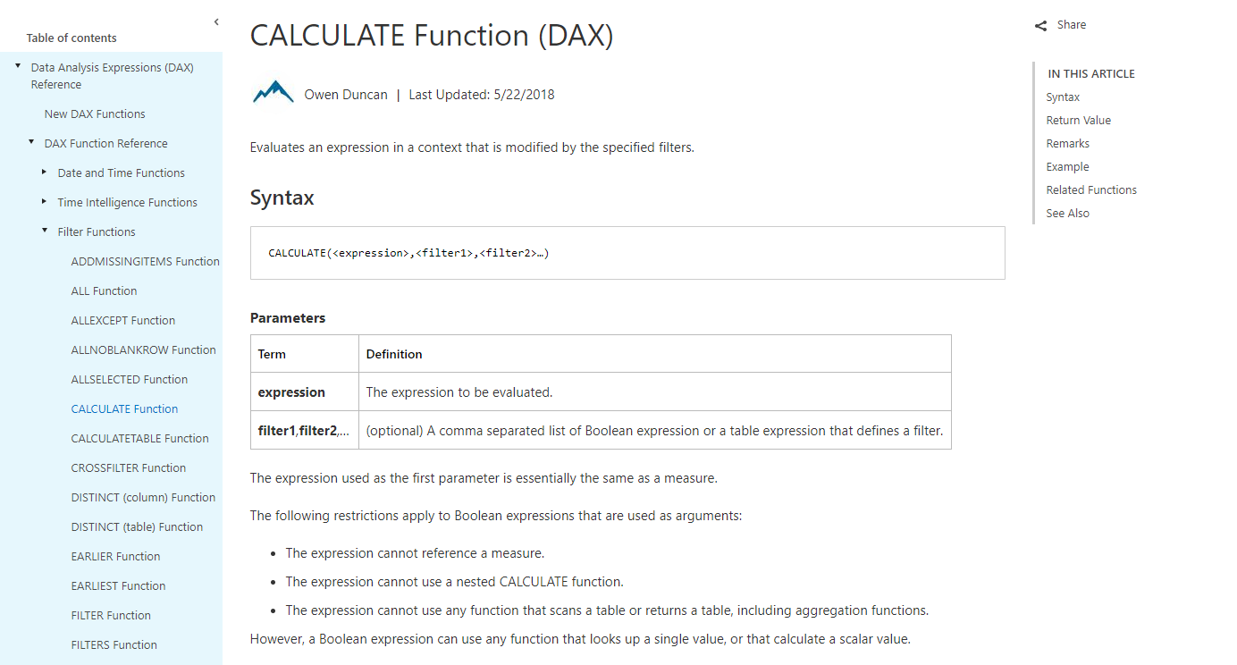

Slide 47
Module 4c – Popular DAX Expressions
MSDN gives every function:
Description
Syntax & Parameters for function
Return Value
Example
Remarks & Related

Slide 48
Module 4c – Popular DAX Expressions
DAX Function Main Categories
Date and Time Functions
Time Intelligence Functions
Filter Functions
Information Functions
Logical Functions
Math & Trig Functions
Statistical Functions
Text Functions

Slide 49
Module 4c – Popular DAX Expressions
Math & Trig (and Statistical) Basics
SUM
ROUND
DIVIDE
AVERAGE
COUNTROWS
DISTINCTCOUNT
Math & Trig (and Statistical) Advanced
MAX
MIN
MEDIAN
RANKX
TOPN
SUMMARIZE
COUNTX
SUMX

Slide 50
Module 4c – Popular DAX Expressions (Math & Trig)
Math & Trig (and Statistical) Highlights
SUM
DIVIDE
Always use this for your Divisions!
DIVIDE(<numerator>, <denominator> [,<alternateresult>])
COUNTROWS
Your basic Count a table (just a Table)
DISTINCTCOUNT
Distinct values in 1 Column (only takes 1 column)
MAX
MAX value of a column
SUMMARIZE
Return a table that is like a Pivot Table (All accounts first purchase Date)

Slide 51
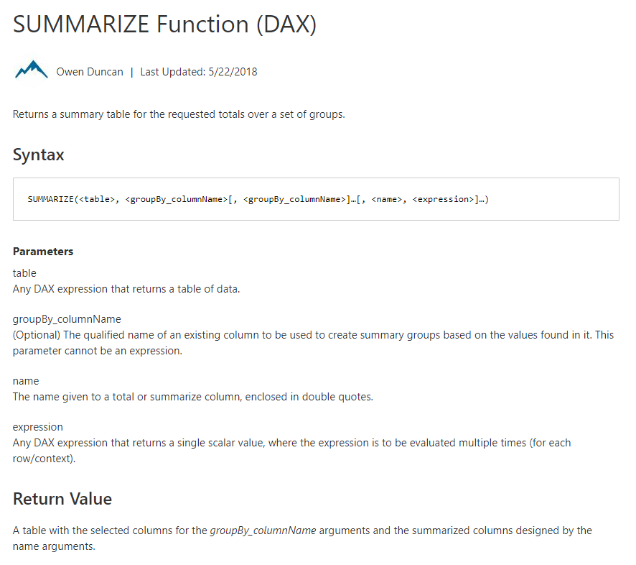
SUMMARIZE
Returns a Table
Summary by Groups

Slide 52
Module 4c – Popular DAX Expressions
Filter Functions (Basic)
CALCULATE
DISTINCT
VALUES
FILTER
USERELATIONSHIP
RELATED
SELECTEDVALUE
Filter Functions (Advanced)
CALCULATETABLE
ALL
ALLSELECTED
ALLEXPECT
EARLIER
ISFILTERED

Slide 53
Module 4c – Popular DAX Expressions – Filter
Filter Functions Highlights
CALCULATE
The Super Star
DISTINCT
Returns a table with 1 column of distinct values
FILTER
The other star
RELATED
Get value from another table related to it
USERELATIONSHIP
Activate an inactive relationship
SELECTEDVALUE
Returns a singular value in context of a column name
ISFILTERED
Checks to see if a measure is filtered

Slide 54
Module 4c – Popular DAX Expressions
Information Functions
ISBLANK
LOOKUPVALUE
CONTAINS
ISERROR
Logical Functions
AND
IF
IFERROR
IN
SWITCH
TRUE

Slide 55
Module 4c – Popular DAX Expressions – Info & Logic
Information & Logical Functions Highlights
IN
Returns true for values (multiple types)
ISBLANK
Checks to see if something is Blank
LOOKUPVALUE
Like Excel VLOOKUP or INDEX MATCH
IF
You know
SWITCH
Your multiple IF THEN nested but much more powerful
TRUE

Slide 56
Module 4c – Popular DAX Expressions
Text Functions (Basic)
CONCATENATE
FIND
FORMAT
LEFT
LEN
MID
RIGHT
SEARCH

Slide 57
Module 4c – Popular DAX Expressions
Date and Time
CALENDAR
DATE
DAY
EDATE
HOUR
MINUTE
MONTH
NOW
TODAY
WEEKDAY
YEAR
DATEDIFF
Time Intelligence (Basic)
DATESMTD
DATESQTD
DATESYTD
LASTDATE
LASTNONBLANK
TOTALMTD
TOTALQTD
TOTALYTD

Slide 58
Module 4c – Popular DAX Expressions
Time Intelligence (Advanced)
DATEADD
DATESBETWEEN
DATESINPERIOD
PARALLELPERIOD
PREVIOUSYEAR
SAMEPERIODLASTYEAR

Slide 59
Module 4c – Popular DAX Expressions - Date
Date & Time Intelligence Highlights
DATEADD
DATESBETWEEN
DATESINPERIOD
SAMEPERIODLASTYEAR
DATESMTD, DATESYTD
DATE

Slide 60
Module 4 DAX Evaluation Contexts

Slide 61
MODULE 4 OBJECTIVES
Understand that there are different kinds of evaluation contexts and be able to explain what different contexts are in play
Be able to use iterator functions and CALCULATE to create sophisticated measures

Slide 62
PATH to DAX Expertise
DAX Foundations
Evaluation Contexts
CALCULATE
Calculated Columns and Measures

Slide 63
Evaluation Context
DAX Foundations
There are two contexts under which calculations are evaluated
Row Context
Filter Context
Notes:
Two gods you can invoke in your DAX calculation
Can be blended in a single calculations

Slide 64
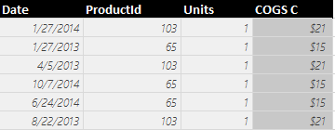
Row context in Calculated Column
DAX Foundations
Sales[COGS] = RELATED(ProductDim[Unit Cost]) * Sales[Units]
Formula is evaluated row by row
The context under which formula is evaluated for each row is called “Row Context”
Pro Tip: To accumulate up from Fact to Dimension, use RELATEDTABLE()
Notes:
Row context invoked when you refer to a column in a calculated column formula without an aggregation function surrounding it
Row Context – How many units sold in Row 1?

Slide 65
Evaluation Context
DAX Foundations
Both Calculated Columns and Measures are always evaluated under two contexts
Row Context
Filter Context
Notes:
Filter Context is defined by the Visual

Slide 66
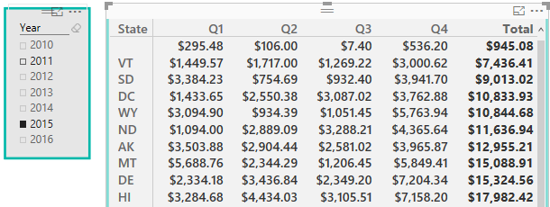
Filter Context in Measures
DAX Foundations
[Total Sales] = SUM(Sales[Sales Amount])
Filter Context for current coordinate
Year = 2015,
State = HI,
Quarter = Q1
Formula is evaluated for each “Coordinate” in each visual
The context for each coordinate is called “Filter Context”
Notes:
Discuss the filter context for the selected cell

Slide 67
Filter Context in a Measure – Example 2
DAX Foundations
[Total Sales] = SUM(Sales[Sales Amount])
Filter Context for current coordinate
Year = 2015,
State = ND,
Quarter = Q3
Notes:
One filter context for each COORDINATE in each Visual
Which subset of data are you using to calculate the number

Slide 68
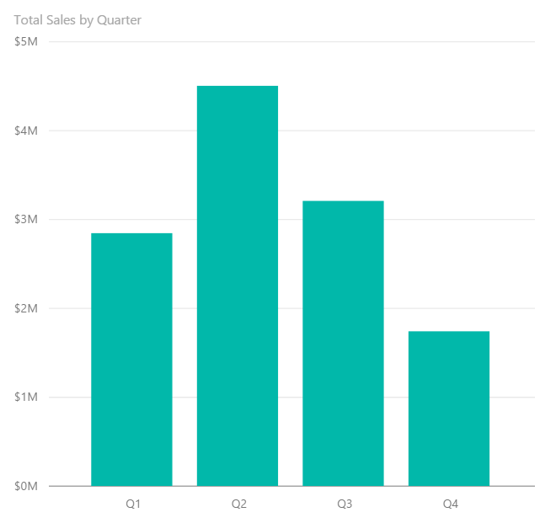
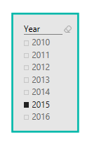
Filter Context in a Measure – Example 3
DAX Foundations
[Total Sales] = SUM(Sales[Sales Amount])
Filter Context : Year = 2015, Quarter = Q1
Filter Context : Year = 2015, Quarter = Q2
Notes:
Charts and Graphs also have Filter Context. EACH data point has a unique Filter Context

Slide 69
Filter Context in a Measure
DAX Foundations
[Total Sales] = SUM(Sales[Sales Amount])
Better definition of above measure:
“Total Sales” – SUM of Sales[Sales Amount] column under a filter context
Notes:
A measure is not evaluated until it is in a Visual – and will be under a filter context

Slide 70
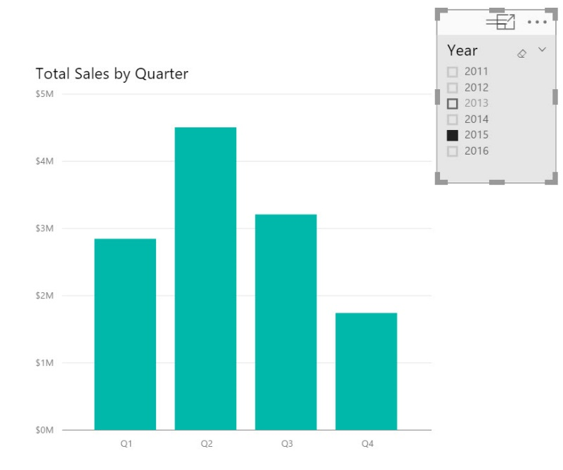
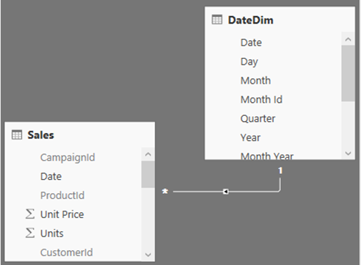
Filter Context and Multiple Tables
DAX Foundations
Filter context automatically propagates from Dim Table to Fact Table
Filtering the DateDim Table to Year = 2015 returns only Sales for 2015
Notes:
In a Uni-Directional relationship, the filter can only flow from the Dim to the Fact
In a BI-Directional relationship, the filter can flow each way.

Slide 71
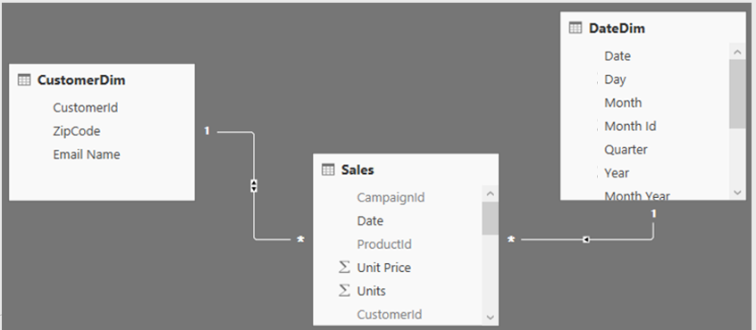
Filter Context and Multiple Tables
DAX Foundations
Filters (Filter context) automatically propagate based on direction of arrows in relationships
Examples
Filter goes from DateDim to CustomerDim
Filter does not go from CustomerDim to DateDim
Notes:
In a Uni-Directional relationship, the filter can only flow from the Dim to the Fact
In a BI-Directional relationship, the filter can flow each way.

Slide 72
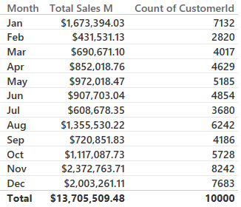
Filter Context and Multiple Tables – Right Arrow Direction
DAX Foundations
Cross filtering works properly
Arrow allows filters
Arrow allows filters
Filter goes from DateDim to CustomerDim
This is why the above Pivot table works
Notes:
DEMO: Show going to the data model and updating the relationship from Single to Both (or back)
Why can’t I just enable all bi-directional relationships
They are expensive
Only turn them from Uni- to Bi- when absolutely necessary

Slide 73
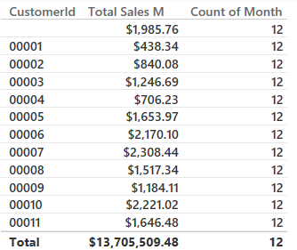
Filter Context and Multiple Tables – Wrong Arrow Direction
DAX Foundations
Cross filtering does not work
Arrow allows filters
Arrow does not allow filters to flow to DateDim
Filter goes from DateDim to CustomerDim
This is why the Count of Month in the table above is incorrect
Notes:
DEMO – Filter Context Multiple Table tab

Slide 74
Evaluation Context Multiple Table – Summary and Take Aways
DAX Foundations
Row Context
Filter Context
Does not propagate automatically
Need to use
RELATED
RELATEDTABLE
Propagates automatically
Depends on direction of arrow in relationship diagram

Slide 75
DAX Function Types
DAX Foundations
Scalar Functions
Table Functions
Scalar functions return a Single value as an output
Ex. SUM(Sale[Sales Amount])
Table functions return a Table as an output
Ex. ALL(GeographyDim)
There are other ways to classify functions – By kind of operation they perform etc.
Notes:
Scalar is a fancy word for using a single coordinate in the evaluation
What if you want bring in a Table or List of values and apply your calculation to them?

Slide 76
Applications of Table functions
DAX Foundations
Table functions can be used 2 ways in Power BI Desktop
As an input to another DAX function
CALCULATE
Iterator functions
Calculated Tables
Notes:
Demo CALCULATED Table example in Power BI Desktop model
Call out the fact that CALCULATED Tables are just like a calculated column – Calculated during processing time or refresh time
You can use this table just like any other DAX in the model – You can create relationships etc.
Go to the Desktop and create a new Demo Table = ALL(GeographyDim) – duplicate with a separate memory footprint.

Slide 77
Basic TABLE functions
DAX Foundations
Return All Rows
Return Distinct Rows
Return Filtered Rows
ALL & variants
ALL, DISTINCT, VALUES
FILTER
There are more advanced Table functions, which we will not cover
Notes:
We will discuss three classes of Table function
No demo yet.

Slide 78
Basic Table functions – Return All Rows
DAX Foundations
The ALL function - Can take either Table or Columns in a Table as input
ALL with Entire Table
ALL with One Column
ALL with Multiple Columns
ALL(GeographyDim)
ALL(GeographyDim[Region]))
ALL(GeographyDim[Region],
GeographyDim[State])
Returns all rows all columns in Table
Returns all unique values of Column
Returns all unique combinations of Column values
Notes:
Demo:
Create a Demo Calculated Table. Discuss Calculated Tables and how are they created.
DemoTable = All(GeographyDim).
Calculated Tables can be used like any other table
You can Build relationships
You can use this to test other complex Table functions
These are like Calculated Columns – Computed during process time
Show ALL and its variants – Start with ALL and work your way through (use slide as a guide)

Slide 79
Basic Table functions – ALL versions
DAX Foundations
There are several forms of the ALL function
ALL
ALLEXCEPT - Return all columns in a Table except 1 or more columns
ALLSELECTED – Return all values in a column selected by users in Slicers
ALLNONBLANKROW – Return all non-Blank rows
Notes:
We demonstrated these functions in the CALCULATE section
Table1 – has a duplicate row
When I write ALL on the whole table, I get the whole table
When I write ALL on the two columns of the table, it removes duplicates
Blank vs a mismatch
ALLEXCEPT - Overrides all context filters in the table except over the specified columns; useful when you want only one column on a table to be sliceable
ALLSELECTED – just like ALL, but if the column is specifically selected, then it respects the slicer
ALLNONBLANKROW – Just like ALL, but does not return any blank rows

Slide 80
Basic Table Functions – Return Distinct Rows
DAX Foundations
VALUES – Return all distinct values in a column or Table
(including blank rows)
DISTINCT - Return all distinct values in a column or Table
(not including blank rows)
Notes:
If when you write VALUES and get a blank you may have Blank or MisMatch
If you change a VALUES to DISTINCT and you still have blank – then it is a real blank – NOT A MISMATCH
Blank vs a mismatch – If your model has Fact rows which do not match with dimensions, this is a mismatch – not a true blank.

Slide 81
Basic Table Functions – Return Filtered Set of Rows
DAX Foundations
FILTER(ALL(GeographyDim[Region], GeographyDim[State]), GeographyDim[Region] = “Central”)
Take all unique combinations of GeographyDim[Region], GeographyDim[State]
Filter down to the rows where GeographyDim[Region] = “Central”
Notes:
The Region = “Central” is in a ROW Context as it is not surrounded by aggregate function

Slide 82
DAX Iterator Functions Take Advantage of Evaluation Context
DAX Foundations
Iterator Functions
Creates a row context by iterating over a table that you specify
Ex. SUMX
Notes:
The table could be calculated ALL(DimGeography[State]) or a table in the data model DimGeography

Slide 83
Table Functions Application – Iterators
DAX Foundations
[COGS] = SUMX(Sales, Sales[Units] * RELATED(ProductDim[Unit Cost]))
Argument 1
Argument 2
Notes:
An iterator function takes two arguments – we will walk through this example over the next couple of slides

Slide 84
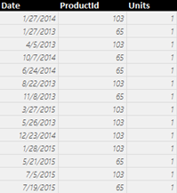
Table Functions Application – Iterators
DAX Foundations
[COGS] = SUMX(Sales, Sales[Units] * RELATED(ProductDim[Unit Cost]))
Argument 1
Iterate through each row in Argument 1
Sales
Notes:
Like a virtual calculated column, but don’t need to perpetually keep the column.
Argument 1 – iterate thru each of the columns in the table argument

Slide 85
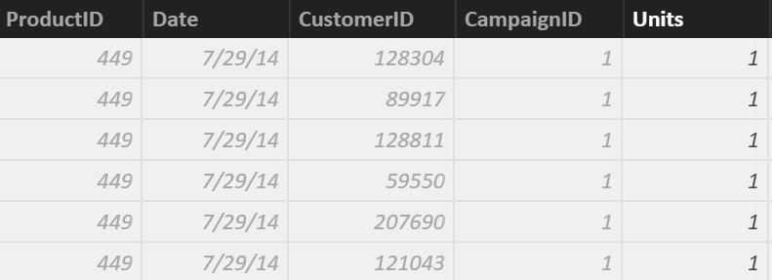
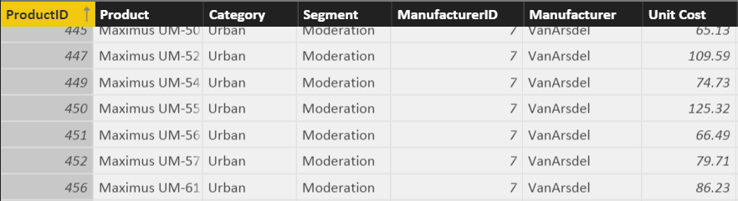
Table Functions Application – Iterators
DAX Foundations
[COGS] = SUMX(Sales, Sales[Units] * RELATED(ProductDim[Unit Cost]))
Argument 2
Sales
ProductDim
Notes:
Perform the calculation for each row in the table argument

Slide 86
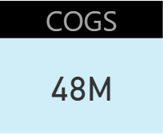
Row Context in a Measure – Iterator Functions
DAX Foundations
[COGS] = SUMX(Sales, Sales[Units] * RELATED(ProductDim[Unit Cost]))
SUM it up
SUM up list obtained
Notes:
Sum the results of all the rows.
Note: This calculation respects the Filter Context of the visual
This example is effectively SumProduct in Excel

Slide 87
Why Can an Iterator be a Better Approach then a Calculated Column?
DAX Foundations
You avoid creating a Calculated Column
Let us see the impact of a Calculated Column Called COGS on Data model with 100K rows - What if we have 10 M rows?
Iterators help you avoid several “Intermediate Calculated Columns”
Notes:
DEMO: In your working copy of “Student Modeling Pre-class.pbix” where you have the calculated column [COGS] –
* Save the file and note the size for the class
* Remove the [COGS] calculated Column and re-save the file.
* Note that the file size is about 8% smaller. While file size is not an exact measure of memory use, it is a proxy that most students understand.

Slide 88
Iterator Function Example 2 – Dynamic Segmentation
DAX Foundations
Sales Velocity Segment = IF(
SUMX(RELATEDTABLE(Sales), Sales[Sales Amount])>=200000,
“High Velocity”,
“Low Velocity”
)
Notes:
FYI: This is a calculated column!
DEMO: Show this calculation in the Product Table (Data View)

Slide 89
CALCULATE – Converting Row Context to Filter Context (Example 1)
DAX Foundations
Sales velocity Segment = IF(
SUMX(RELATEDTABLE(Sales), Sales[Sales Amount])>=200000,
“High Velocity”,
“Low Velocity”)
Sales Velocity (Using CALCULATE) = IF (
CALCULATE(SUM(Sales[Sales Amount])) >= 200000,
"High Velocity",
"Low Velocity")
Another way to do Dynamic Segmentation
This method does not use Iterators
Instead it uses CALCULATE to convert Row Context to Filter Context
Notes:
Walk through demo:
Go to ProductDImTable
Show calculated Column

Slide 90
Iterator Function Example 3 – Ranking Using Iterators in Calc. Column – CALCULATE to convert Row Context to Filter Context
DAX Foundations
Rank Of Sales =
VAR CurrentProductSales = CALCULATE ( SUM (Sales[Sales Amount] ) )
RETURN
SUMX(FILTER(ProductDim, CALCULATE ( SUM (Sales[Sales Amount] ) ) > CurrentProductSales), 1)+1
Notes:
Combines multiple concepts we have been talking about
This is an alternative to RankX (if they have same sales, they will have same rank)
Nesting the row Context with an iterator
Avoiding the EARLIER syntax
This is a “Lazy” calculation – performs the calculation one time and is used by the SUMX

Slide 91
Other Iterator Functions
DAX Foundations
AVERAGEX , PRODUCTX, MINX, MAXX– All work the same way as SUMX
RANKX – Works similar to SUMX, but slightly more complex (more options)

Slide 92
Table Functions – Summary and Application
DAX Foundations
Table functions can be used in 2 ways in Power BI Desktop:
As an input to another DAX function
CALCULATE
Iterator functions
Calculated Tables
CALCULATE is one of the primary places where Table functions are used

Slide 93
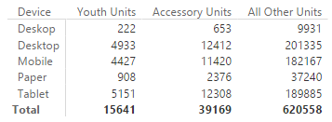
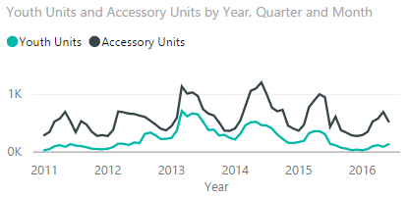
Module 4 Lab
Create a report for the VP in charge of the Youth and Accessory Segments
Include a table visualization showing total units sold in the Youth Segment, Accessory Segment, and all other segments; by Campaign Device
Include a line chart showing total units sold in Youth and Accessory Segments by month
BONUS: Use the Unit Cost and Unit Price from the ProductDim table to calculate Sales Amount, Cost of Goods Sold, Profit and build some visuals around them
Notes:
Expected results: users will need to create 3 measures to accomplish #1 and #2 :
- Youth Units Sold = CALCULATE([Total Units Sold],FILTER(ProductDim,ProductDim[Segment]="Youth"))
- Accessory Units Sold = CALCULATE([Total Units Sold],FILTER(ProductDim,ProductDim[Segment]="Accessory"))
- Rest of Company Units Sold = CALCULATE([Total Units Sold],FILTER(ALL(ProductDim),AND(ProductDim[Segment]<>"Accessory",ProductDim[Segment]<>"Youth")))
The visuals are a simple table and fairly straightforward line chart (be sure to use Date from DateDim)
For #3, users will need to create three measures :
Sales Amount M = SUMX(Sales, Sales[Units] * RELATED(ProductDim[Unit Price]))
COGS M = SUMX(Sales, Sales[Units] * RELATED(ProductDim[Unit Cost]))
Profit M = SUMX(Sales, Sales[Units] * (RELATED(ProductDim[Unit Price]) - RELATED(ProductDim[Unit Cost])))
alternatively, Profit M = [Sales Amount M] - [COGS M]
alternatively, users could accomplish this via calculated columns but this is not preferred.

Slide 94
KNOWLEDGE CHECK Module 4
What are the different kinds of evaluation contexts?
When are filter or a row contexts present?
Which functions are commonly used to modify existing evaluation contexts?

Slide 95
Module 5
Advanced DAX Time Intelligence Functions

Slide 96
MODULE OBJECTIVES
Be able to parse advanced DAX formulas (e.g., cumulative functions)
Gain familiarity with standard DAX patterns
Introduction to resources for further learning

Slide 97
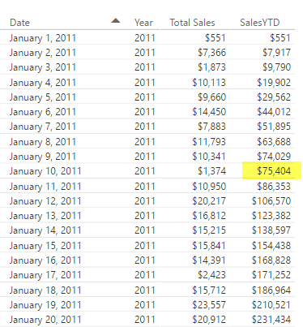
Before we get to Time Intelligence - Let us apply all of the DAX techniques
Advanced DAX
[SalesYTD] =
CALCULATE (
[Total Sales],
FILTER (
ALL ( DateDim),
DateDim[Year] = MAX ( DateDim[Year] )
&& DateDim[Date] <= MAX(DateDim[Date])
)
)
Let us take a super complicated DAX statement and break it down and understand what it means
Notes:
Tab: Time Intelligence-YTD
Slides walk thru the logic – Follow the narrative of the next 5 slides

Slide 98
Before we get to Time Intelligence - Let us apply all of the DAX techniques
Advanced DAX
[SalesYTD] =
CALCULATE (
[Total Sales],
FILTER (
ALL ( DateDim),
DateDim[Year] = MAX ( DateDim[Year] )
&& DateDim[Date] <= MAX( DateDim[Date] )
)
)
In a CALCULATE statement Filter arguments are evaluated first
The Filter in this case comes from a FILTER function
FILTER function is an iterator

Slide 99
Let us apply all of the data modeling techniques
Advanced DAX
[SalesYTD] =
CALCULATE (
[Total Sales],
FILTER (
ALL ( DateDim),
DateDim[Year] = MAX ( DateDim[Year] )
&& DateDim[Date] <= MAX( DateDim[Date] )
)
)
In a FILTER statement the input Table is evaluated first
ALL statement means take all DateDim

Slide 100
Let us apply all of the data modeling techniques
Advanced DAX
[SalesYTD] =
CALCULATE (
[Total Sales],
FILTER (
ALL ( DateDim),
DateDim[Year] = MAX ( DateDim[Year] )
&& DateDim[Date] <= MAX(DateDim[Date] )
)
)
Iterate through each row in DateDim
Check for condition based on row context and filter context
Pro Tip: if you need to concatenate two conditions with an AND use && for and OR use ||

Slide 101
Let us apply all of data modeling techniques
Advanced DAX
[SalesYTD] =
CALCULATE (
[Total Sales],
FILTER (
ALL ( DateDim),
DateDim[Year] = MAX ( DateDim[Year] )
&& DateDim[Date] <= MAX(DateDim[Date] )
)
)
Now you have a FILTERED list of dates
Use this to update the filter context (since it is in a CALCULATE statement)

Slide 102
Let us apply all of the data modeling techniques
Advanced DAX
[SalesYTD] =
CALCULATE (
[Total Sales],
FILTER (
ALL ( DateDim),
DateDim[Year] = MAX ( DateDim[Year] )
&& DateDim[Date] <= MAX(DateDim[Date] )
)
)
Use updated FILTER context to evaluate ‘Total Sales’

Slide 103
Introducing Time Intelligence – There is an App for that!!
Advanced DAX – Time Intelligence
[SalesYTD Easier] =
CALCULATE (
[Total Sales],
DATESYTD(DateDim[Date])
)
This allows you to write the formula without being a DAX guru!
Microsoft is continuously improving Time Intelligence functions to make it simple to use
Time Intelligence functions are your friends – They will save you time!

Slide 104
Month Over Month
Advanced DAX – Time Intelligence
Total Sales Last Month =
CALCULATE([Total Sales],
PREVIOUSMONTH(DateDim[Date]))
MoM =
DIVIDE([Total Sales] - [Total Sales Last Month],
[Total Sales Last Month])
DAX has several shortcut Time Intelligence functions
Notes:
Additional calculations to discuss commonly used scenarios
Calculates based on same day in prior month
MoM – Month over Month

Slide 105
Monthly Active Users
Advanced DAX – Time Intelligence
[Monthly Active Users] =
CALCULATE(
SUMX(VALUES(Sales [CustomerId]),1),
ALL('DateDim'),
DATESINPERIOD('DateDim'[Date],
LASTDATE('DateDim'[Date]), -1, MONTH)
)
Sumx vs DistinctCount of CustomerID
SUMX can be more performant
Notes:
Another commonly used scenario
Calculates based on same day in prior month – Discuss usage of DATESINPERIOD and LASTDATE

Slide 106
Other Time Intelligence Functions
Advanced DAX – Time Intelligence
DATESINPERIOD
DATESYTD
DATESQTD
NEXTMONTH NEXTYEAR
PREVIOUSYEAR PREVIOUSMONTH SAMEPERIODLASTYEAR
PARALLELPERIOD
Pro Tip: Learn about Time Intelligence functions - https://msdn.microsoft.com/en-us/library/ee634763.aspx

Slide 107
KNOWLEDGE CHECK Module 5
Can I parse advanced DAX formulas?
What are some standard DAX patterns?
Which time intelligence functions are built-in to DAX?

Slide 108
Power BI Support Resources
Contact Support
Report Errors, Issues – Support.PowerBI.com
Resources use presentation mode to click the hyperlinks
Community.PowerBI.com – Community Forum
Data Stories Gallery – Get inspired with Data Stories by other Power BI users
R-Visuals Gallery – Get inspired by others use of R for analyzing their data
Visuals.PowerBI.com – Custom PBI visuals and R visuals you can download and use in your story
Power BI Blog - weekly updates
User Voice for Power BI – Vote on (or submit) your favorite new ideas for Power BI
Issues.PowerBI.Com – log issues with the community
Guided Learning Self Service Power BI training
DAX Formula Language – syntax for DAX
DAX Patterns – Great website to learn new patterns for the DAX Language
Power Query Formula Language – syntax for the “Query” language
Instructors:
Notes:
External Support Resources for Microsoft

Slide 109
Questions?

Slide 110
Appendix

Slide 111
KNOWLEDGE CHECK ANSWERS Module 1
What is a data model in the context of Power BI?
A data model is a collection of tables and relationships
What are some advantages of a star schema over a flat or denormalized model?
Dimension tables save space by reducing the amount of data that needs to be repeated over and over in every row
Relationships between tables can be leveraged for more complex measures
How might you improve the performance of a Power BI model?
Try using a star schema instead of a flat or denormalized model
Remove unnecessary columns
Set appropriate data types
How does Power BI store DateTime information? What are some consequences of this?
DateTime information is stored as a floating-point decimal number. This means that datetimes are very precise but not very efficient to store.

Slide 112
KNOWLEDGE CHECK ANSWERS Module 2
When is Calculated Column Evaluated?
At the time of data load/data refresh.
What is Default Summarization?
A default summarization is an implicit measure created in the background when you put a numeric field on a visualization. The function used (sum/max/min/avg/…) is based on the numeric field’s default summarization setting.
When is a Measure Evaluated?
At render time.
When to use Measures and Calculated Columns?
It depends ☺. Calculated columns are useful when each row of data should be independently considered (although measures can do this too!) and the result won’t change until the next data refresh. Measures should be used everywhere else.

Slide 113
KNOWLEDGE CHECK ANSWERS Module 4
What are the different kinds of evaluation contexts?
Filter context and row context
When are filter or a row contexts present?
Row contexts are present in iterator functions and calculated column evaluations. Filter contexts are present in pivot tables and other visualizations.
Which functions are commonly used to modify existing evaluation contexts?
CALCULATE, ALL, etc.

Slide 114
KNOWLEDGE CHECK ANSWERS Module 5
Can I parse advanced DAX formulas?
Yes I can!
What are some standard DAX patterns?
CALCULATE(…)
Which time intelligence functions are built-in to DAX?
Lots of them…YTD, FY, previous month, etc

Slide 115
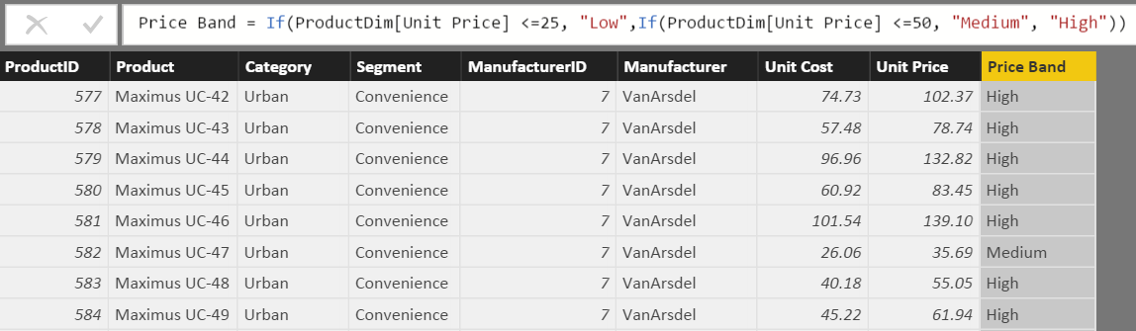
What is a Calculated Column?
DAX Foundations
Calculated Column
Pro Tip: Always refer to a calculated column by its full name -> TableName[ColumnName]
Notes:
Used to add attributes that don’t exist in the source data
See this formula. This looks a lot like Excel
Demo:
In Product Dim Table add the above formula from the Tab called “Calculated Column”

Slide 116
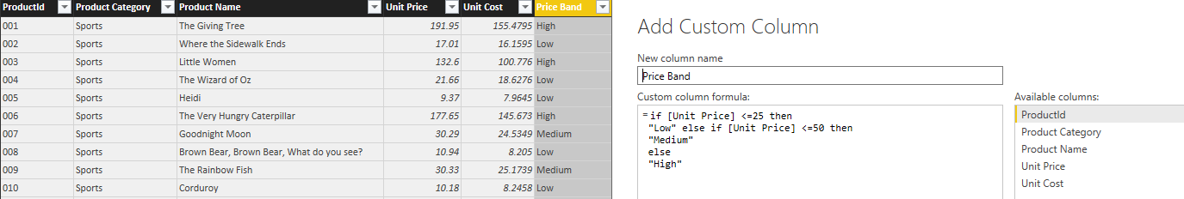
Calculated Column in DAX vs Custom Column in “Query Editor”
DAX Foundations
Note: If given a choice, creating the column in “M” or “Query Editor” will give you better compression.
Notes:
DEMO: If a question comes up related to how to create a calculated column in ”M”, then do the following:
Open Query editor and create a calculated column using this formula:
if [Unit Price] <= 25 then "Low" else if [Unit Price] <=50 then "Medium" else "High“ M is case sensitive and the if/then/else syntax is different than Excel/DAX
Instructor Talking Point, if needed:
Once the column comes in it becomes like any other column in Power BI Desktop file
The column is compressed
There is a secondary processing for Calculated Columns – Which makes process times slower

Slide 117
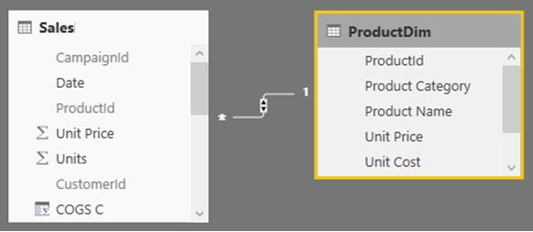
Calculated Column – Accessing columns from other Tables in model
DAX Foundations
Often you want to access columns from multiple tables to create a Calculated Columns
Let us say you want to calculate COGs, which is Units * Units Cost
Units Cost is in another Table

Slide 118
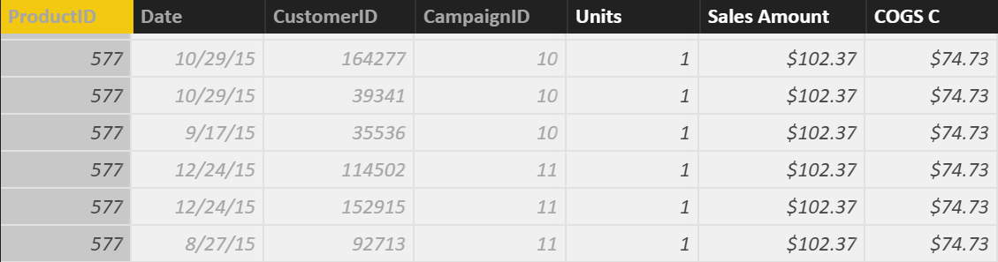
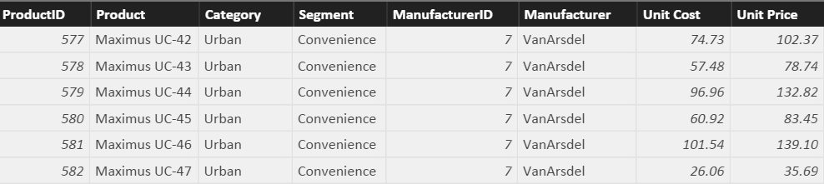
Row Context and Multiple Tables – RELATED Function
DAX Foundations
Sales[COGS] = RELATED(ProductDim[Unit Cost]) * Sales[Units]
RELATED is just like VLOOKUP in Excel
Notes:
First Bring in the column. Let it resolve and then multiply
Demo:
In SalesFact Table write this formula: Sales[COGS] = RELATED(ProductDim[Unit Cost]) * Sales[Units]
(also available in Calculated Column Tab)
Note to instructor: Just like Vlookup but without all of the drama – No NA()

Slide 119
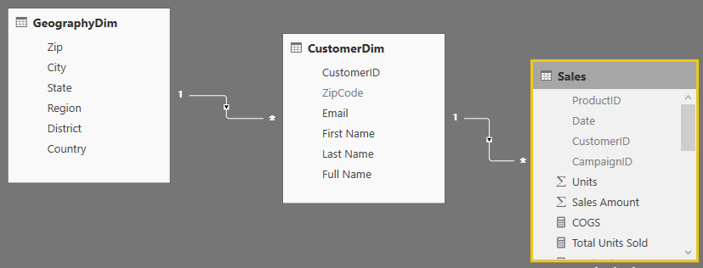
RELATED Function Example
DAX Foundations
You could follow a chain of relationship from Many side to 1 side using RELATED
Sales [City State]= RELATED(GeographyDim[City]) & “, ” & RELATED(GeographyDim[State])
Notes:
This is an example of “Just because you can, does not mean you should”
Creating a calculated column like this on the fact table takes way too much memory when it could just as easily be placed on the GeographyDim table.
No Demo on this slide
Note to Instructor: If you need to aggregate back from 1 side to the Many side, there is a companion formula called RelatedTable – but we will cover that later.

Slide 120
When is a Calculated Column Evaluated?
DAX Foundations
“Get Data” Phase
Model Creation Phase
Model
Enhancement
Phase
Visual
Building Phase
Create Query in “M”
Compress data
Auto detect relationships
Add calc. columns, Measures
Add missing relationships
Evaluate Measures and build each visual
Notes:
Note to Instructor: This has already been covered and is just reinforcing a concept covered in a previous slide.

Slide 121
Best Practices with DAX Calculated Columns
DAX Foundations
Whenever possible, DAX helper columns should be avoided. Each “Helper Column” will consume RAM
Create a calculated column in the Dim Table as opposed to in the Fact Table
Move calculated columns to “M” if you can
Notes:
Instructor Talking Point,
Best Practice is to create a calculated column at the HIGHEST level of granularity - in the highest dim

Slide 122
DAX Foundations
Calculated Column
Measure
Notes:
Instructor Note: This is just a navigation slide

Slide 123
Calculated Measures

Slide 124
Why are Default Summarizations useful?
DAX Foundations
Don’t have to know DAX
Power BI Team is looking to add easier ways to perform calculations using “Quick Measures” and “Show Value As”
Notes:
Instructor Note: Nothing to demo. Slide is self explanatory
“Quick Calcs” has been renamed to “Show Value As”
“Quick Measures” are new in the April release

Slide 125
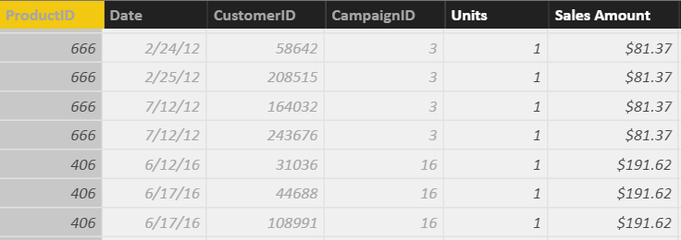
What is a Measure?
DAX Foundations
[Total Sales]=SUM(Sales[Sales Amount])
Measures are created using DAX
Place your Measures on a Fact table for best results
Pro Tip: When referring to a measure in other calculations, refer to it without a Table name: [MeasureName]
Notes:
DEMO:
From the Modeling Ribbon, show measure called Total Sales and that resolves to the same values as default summarization.
Formula: Total Sales = SUM(Sales[Sales Amount])
In the Measure tab, drop the Total Sales measure onto the graph on the right in the values section
Instructor Talking Points:
Explain the calculations in DAX vs Power BI:
On the graph on the top left, the calculations are done by Power BI implicitly.
The graph on the right, show the calculations on the right in DAX which are written, explicitly.
Instructor Note:
Talk about Home Tables. Even though it looks like Measures are in a Fact Table internally they are stored in a separate table called Measures Table
Always ensure the Home Table is a FACT table
Be sure the mention that measures should only be associated with FACT tables, and that measure names must be globally unique within the data model.
If class is interested, may be worth mentioning that the reason measure names must be unique is that they end up being associated with a hidden measures-only table that gets created in the data model

Slide 126
Measure, Use Case 1: Using One Measure in Another
DAX Foundations
Instead of writing this:
[Profit] = SUM(Sales[Sales Amount])-SUM(Sales[COGS])
Write this:
[Profit] = [Total Sales]- [Total COGS]
Allows re-use of measures
Formulas are much simpler to read
Notes:
Advantage to writing DAX
Simplify DAX by referencing other Measures
Quickly reference the list of measures from the formula bar by typing “[“ – As all Measures start with this character

Slide 127
Measure, Use Case 2: More Complex Calculations
DAX Foundations
[Profit Margin %] = [Profit] / [Total Sales]
Ratios are calculations that cannot be created using a Calculated Column or Default Summarization
Use DAX DIVIDE for built in error handling
[Profit Margin %] = DIVIDE([Profit] , [Total Sales])
Notes:
DEMO:
Profit Margin = Sales[Sales Amount] – Sales[Cogs]
Profit Margin % = DIVIDE([Profit Margin], Sum(Sales[COGS]) )

Slide 128
When is a Measure Evaluated?
DAX Foundations
“Get Data” Phase
Model Creation Phase
Model
Enhancement
Phase
Visual
Building Phase
Create Query in “M”
Compress data
auto detect relationships
Add calc. columns, Measures
Add missing relationships
Evaluate Measures and build each visual

